Slide 1
Intro
Containers
I/O
Images
Builder
Security
Ecosystem
Future
Containers - Docker

Slide 2
Intro
Containers
I/O
Images
Builder
Security
Ecosystem
Future
Summary
Introduction
Managing docker containers
Inputs/Outputs
Managing docker images
Building docker images
Security considerations
The ecosystem & the future

Slide 3
Intro
Containers
I/O
Images
Builder
Security
Ecosystem
Future
Part 1. Introduction

Slide 4
Intro
Containers
I/O
Images
Builder
Security
Ecosystem
Future
Containers Vs. VMs
Resource overhead
Time to spin up
Security
Microservice architecture
Notes:
Architecture, resource utilization and startup time, isolation, portability

Slide 5
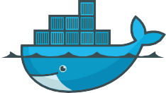
Intro
Containers
I/O
Images
Builder
Security
Ecosystem
Future
What is Docker (1/3)
“Docker is an open platform for developers and sysadmins to build, ship, and run distributed applications.
Consisting of Docker Engine, a portable, lightweight runtime and packaging tool, and Docker Hub, a cloud service for sharing applications and automating workflows, Docker enables apps to be quickly assembled from components and eliminates the friction between development, QA, and production environments. As a result, IT can ship faster and run the same app, unchanged, on laptops, data center VMs, and any cloud.”
source: https://www.docker.com/whatisdocker/

Slide 6
Intro
Containers
I/O
Images
Builder
Security
Ecosystem
Future
What is Docker (2/3)
a container manager
lightweight virtualisation
(host and guest systems share the same kernel)
based on linux namespaces and cgroups
massively copy-on-write
immutable images
instant deployment
suitable for micro-services (one process, one container)
→ immutable architecture
Notes:
Docker uses a kernel to run so need a linux based OS (or WSL) in order to utilize the namespace/cgroup architecture it is built on

Slide 7
Intro
Containers
I/O
Images
Builder
Security
Ecosystem
Future
What is Docker (3/3)
a build system
images may be built from sources
using a simple DSL (Dockerfile)
a set of REST APIs
Engine API (control the docker engine)
Plugin API (extend the engine → network, storage, authorisation)
Registry API (publish/download images)
Swarm API (manage a clusted of docker machines)

Slide 8
Intro
Containers
I/O
Images
Builder
Security
Ecosystem
Future
How Docker helps?
normalisation: same environment (container image) for
development
jobs on the computing grid
continuous integration
peer review
demonstrations, tutorials
technology transfer
archival (ever tried to reuse old codes)
source → Dockerfile = recipe to rebuild the env from scratch
binary → docker image = immutable snapshot of the software with its runtime environment
→ can be re-run at any time later

Slide 9
Intro
Containers
I/O
Images
Builder
Security
Ecosystem
Future
In practice
A docker image is an immutable snapshot of the filesystem A docker container is
a temporary file system
layered over an immutable fs (docker image)
fully writable (copy-on-write)
dropped at container’s end of life (unless a commit is made)
a network stack
with its own private address (by defaut in 172.17.x.x)
a process group
one main process launched inside the container
all sub-processes SIGKILLed when the main process exits

Slide 10
Intro
Containers
I/O
Images
Builder
Security
Ecosystem
Future
Installation
https://docs.docker.com/engine/installation/
Native installation:
requires linux kernel >3.8
Docker Machine:
a command for provisionning and managing docker nodes deployed:
in a local VM (virtualbox)
remotely (many cloud APIs supported)
Notes:
On linux simple apt install, for windows needs wsl or hypervisor to provision a linux vm to run docker (docker desktop) sudo usermod -aG docker [username]
Install on airgapped system: download installer and save needed images on an internet connected machine, on air gapped system install and load images

Slide 11
Intro
Containers
I/O
Images
Builder
Security
Ecosystem
Future
Part 2.
Managing containers
create/start/stop/remove containers
inspect containers
interact, commit new images
Notes:
Images and containers are like class and instance (blueprint and actuation)

Slide 12
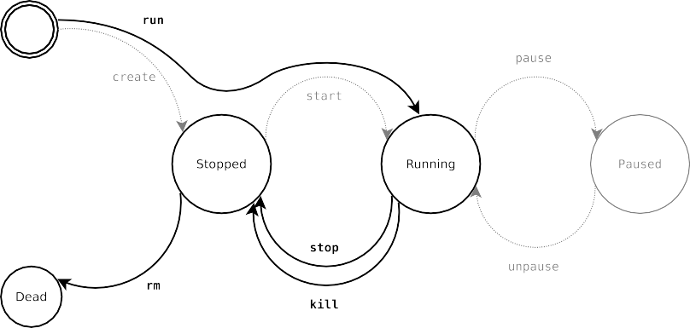
Intro
Containers
I/O
Images
Builder
Security
Ecosystem Future
Lifecycle of a docker container

Slide 13
Intro
Containers
I/O
Images
Builder
Security
Ecosystem
Future
Container management commands
command | description
docker create image [ command ] docker run image [ command ] | create the container = create + start
docker rename container new name docker update container | rename the container update the container config
docker start container. . . docker stop container. . . docker kill container. . . docker restart container. . . | start the container graceful² stop kill (SIGKILL) the container = stop + start
docker pause container. . . docker unpause container. . . | suspend the container resume the container
docker rm [ -f³ ] container. . . | destroy the container
²send SIGTERM to the main process + SIGKILL 10 seconds later
³-f allows removing running containers (= docker kill + docker rm)

Slide 14
Intro
Containers
I/O
Images
Builder
Security Ecosystem
Future
Notes about the container lifecycle
the container filesystem is created in docker create and dropped in docker rm
it is persistent across stop/start
the container configuration is mostly static
config is set in create/run
docker update may change only a few parameters (eg: cpu/ram/blkio allocations)
changing other parameters requires destroying and re-creating
the container
other commands are rather basic
Notes:
Static (immutable), easy to create a new container if change is needed

Slide 15
Intro
Containers I/O Images Builder Security Ecosystem Future
Usage: docker create [OPTIONS] IMAGE [COMMAND] [ARG...] Usage: docker start [OPTIONS] CONTAINER [CONTAINER...]
Create a new container Start one or more stopped containers
-a, --attach=[]
--add-host=[]
--blkio-weight=0
--cpu-shares=0
--cap-add=[]
--cap-drop=[]
--cgroup-parent=
--cidfile=
--cpu-period=0
--cpu-quota=0
--cpuset-cpus=
--cpuset-mems=
--device=[]
Attach to STDIN, STDOUT or STDERR
Add a custom host-to-IP mapping (host:ip)
Block IO (relative weight), between 10 and 1000 CPU shares (relative weight)
Add Linux capabilities Drop Linux capabilities
Optional parent cgroup for the container Write the container ID to the file
Limit CPU CFS (Completely Fair Scheduler) period Limit CPU CFS (Completely Fair Scheduler) quota CPUs in which to allow execution (0-3, 0,1)
MEMs in which to allow execution (0-3, 0,1) Add a host device to the container
-a, --attach=false
--help=false
Attach STDOUT/STDERR and forward signals Print usage
-i, --interactive=false Attach container's STDIN
Usage: docker stop [OPTIONS] CONTAINER [CONTAINER...]
Stop a running container.
Sending SIGTERM and then SIGKILL after a grace period
--disable-content-trust=true Skip image verification
--help=false Print usage
-t, --time=10 Seconds to wait for stop before killing it
--dns=[]
--dns-opt=[]
--dns-search=[]
-e, --env=[]
--entrypoint=
--env-file=[]
--expose=[]
--group-add=[]
-h, --hostname=
--help=false
-i, --interactive=false
--ipc=
--kernel-memory=
-l, --label=[]
--label-file=[]
--link=[]
--log-driver=
--log-opt=[]
--lxc-conf=[]
-m, --memory=
--mac-address=
--memory-reservation=
--memory-swap=
--memory-swappiness=-1
--name=
--net=default
--oom-kill-disable=false
-P, --publish-all=false
-p, --publish=[]
--pid=
--privileged=false
--read-only=false
--restart=no
--security-opt=[]
--stop-signal=SIGTERM
-t, --tty=false
-u, --user=
--ulimit=[]
--uts=
-v, --volume=[]
--volume-driver=
--volumes-from=[]
-w, --workdir=
Set custom DNS servers Set DNS options
Set custom DNS search domains Set environment variables
Overwrite the default ENTRYPOINT of the image Read in a file of environment variables Expose a port or a range of ports
Add additional groups to join Container host name
Print usage
Keep STDIN open even if not attached IPC namespace to use
Kernel memory limit
Set meta data on a container
Read in a line delimited file of labels Add link to another container
Logging driver for container Log driver options
Add custom lxc options Memory limit
Container MAC address (e.g. 92:d0:c6:0a:29:33) Memory soft limit
Total memory (memory + swap), '-1' to disable swap Tuning container memory swappiness (0 to 100) Assign a name to the container
Set the Network for the container Disable OOM Killer
Publish all exposed ports to random ports Publish a container's port(s) to the host PID namespace to use
Give extended privileges to this container
Mount the container's root filesystem as read only Restart policy to apply when a container exits Security Options
Signal to stop a container, SIGTERM by default Allocate a pseudo-TTY
Username or UID (format: <name|uid>[:<group|gid>]) Ulimit options
UTS namespace to use Bind mount a volume
Optional volume driver for the container Mount volumes from the specified container(s) Working directory inside the container
Usage: docker restart [OPTIONS] CONTAINER [CONTAINER...]
Restart a container
--help=false Print usage
-t, --time=10 Seconds to wait for stop before killing the container
Usage: docker kill [OPTIONS] CONTAINER [CONTAINER...]
Kill a running container
--help=false Print usage
-s, --signal=KILL Signal to send to the container
Usage: docker rm [OPTIONS] CONTAINER [CONTAINER...]
Remove one or more containers
-f, --force=false
--help=false
-l, --link=false
Force the removal of a running container (uses SIGKILL) Print usage
Remove the specified link
-v, --volumes=false Remove the volumes associated with the container
Usage: docker pause [OPTIONS] CONTAINER [CONTAINER...]
Pause all processes within a container
--help=false Print usage
Notes:
Not really sure about this slide?

Slide 16
Intro
Containers
I/O
Images
Builder
Security
Ecosystem
Future
docker run — Run a container
https://docs.docker.com/reference/run/
docker run [ options ] image [ arg0 arg1...]
→ create a container and start it
the container filesystem is initialised from image image
arg0..argN is the command run inside the container (as PID 1)
$ docker run debian /bin/hostname
f0d0720bd373
$ docker run debian date +%H:%M:%S
17:10:13
$ docker run debian true ; echo $?
0
$ docker run debian false ; echo $?
1
Notes:
Explain the output of each run maybe run a nginx container and access it via browser?

Slide 17
Intro
Containers
I/O
Images
Builder
Security
Ecosystem Future
docker run — Foreground mode vs. Detached mode
Foreground mode is the default
stdout and stderr are redirected to the terminal
docker run propagates the exit code of the main process
With -d, the container is run in detached mode:
displays the ID of the container
returns immediately
$ docker run debian date
Tue Jan 20 17:32:07 UTC 2015
$ docker run -d debian date
4cbdefb3d3e1331ccf7783b32b47774fefca426e03a2005d69549f3ff06b9306
$ docker logs 4cbdef
Tue Jan 20 17:32:16 UTC 2015

Slide 18
Intro Containers
I/O
Images
Builder
Security
Ecosystem
Future
docker run — TTY allocation
Use -t to allocate a pseudo-terminal for the container
→ without a tty
$ docker run debian ls
bin boot dev
...
$ docker run debian bash
$
→ with a tty (-t)
$ docker run -t debian ls
bin dev home lib64 mnt proc run selinux sys usr
boot etc lib media opt root sbin srv
$ docker run -t debian bash
root@10d90c09d9ac:/#
tmp var

Slide 19
Intro
Containers
I/O
Images
Builder
Security
Ecosystem
Future
docker run — interactive mode
By default containers are non-interactive
stdin is closed immediately
terminal signals are not forwarded⁴
$ docker run -t debian bash root@6fecc2e8ab22:/# date ˆC
$
With -i the container runs interactively
stdin is usable
terminal signals are forwarded to the container
$ docker run -t -i debian bash
root@78ff08f46cdb:/# date Tue Jan 20 17:52:01 UTC 2015
root@78ff08f46cdb:/# ˆC
root@78ff08f46cdb:/#
⁴ˆC only detaches the terminal, the container keeps running in background

Slide 20
Intro Containers
I/O
Images
Builder
Security
Ecosystem
Future
docker run — override defaults (1/2)
user (-u)
$ docker run debian whoami
root
$ docker run -u nobody debian whoami
nobody
working directory (-w)
$ docker run debian pwd
/
$ docker run -w /opt debian pwd
/opt

Slide 21
Intro Containers
I/O
Images
Builder
Security
Ecosystem
Future
docker run — override defaults (2/2)
environment variables (-e)
$ docker run debian sh -c 'echo $FOO $BAR'
$ docker run -e FOO=foo -e BAR=bar debian sh -c 'echo $FOO $BAR'
foo bar
hostname (-h)
$ docker run debian hostname
830e47237187
$ docker run -h my-nice-container debian hostname
my-nice-hostname

Slide 22
Intro Containers
I/O
Images
Builder
Security
Ecosystem
Future
docker run — set the container name
--name assigns a name for the container
(by default a random name is generated)
$ docker run -d -t debian
da005df0d3aca345323e373e1239216434c05d01699b048c5ff277dd691ad535
$ docker run -d -t --name blahblah debian
0bd3cb464ff68eaf9fc43f0241911eb207fefd9c1341a0850e8804b7445ccd21
$ docker ps
CONTAINER ID
0bd3cb464ff6 da005df0d3ac
IMAGE COMMAND CREATED
debian:7.5 "/bin/bash" 6 seconds ago debian:7.5 "/bin/bash" About a minute ago
.. NAMES
blahblah drunk_darwin
$ docker stop blahblah drunk_darwin
Note: Names must be unique
$ docker run --name blahblah debian true
2015/01/20 19:31:21 Error response from daemon: Conflict, The name blahblah is already assigned to 0bd3cb464ff6. You have to delete (or rename) that container to be able to assign blahblah to a container again.

Slide 23
Intro Containers
I/O
Images Builder
Security
Ecosystem
Future
docker run — autoremove
By default the container still exists after command exit
$ docker run --name date-ctr debian date
Tue Jan 20 18:38:21 UTC 2015
$ docker start date-ctr
date-ctr
$ docker logs date-ctr
Tue Jan 20 18:38:21 UTC 2015
Tue Jan 20 18:38:29 UTC 2015
$ docker rm date-ctr
date-ctr
$ docker start date-ctr
Error response from daemon: No such container: date-ctr
2015/01/20 19:39:27 Error: failed to start one or more containers
With --rm the container is automatically removed after exit
$ docker run --rm --name date-ctr debian date
Tue Jan 20 18:41:49 UTC 2015
$ docker rm date-ctr
Error response from daemon: No such container: date-ctr
2015/01/20 19:41:53 Error: failed to remove one or more containers

Slide 24
Intro Containers
I/O
Images
Builder
Security
Ecosystem
Future
Common rm idioms
Launch a throwaway container for debugging/testing purpose
$ docker run --rm -t -i debian
root@4b71c9a39326:/#
Remove all zombie containers
$ docker ps -a
CONTAINER ID IMAGE COMMAND CREATED
STATUS
2b291251a415 debian:7.5 "hostname" About a minute ago Exited (0) About a mi
6d36a2f07e18 debian:7.5 "false" 0f563f110328 debian:7.5 "true"
2 minutes ago
2 minutes ago
Exited (1) 2 minutes
Exited (0) 2 minutes
Exited (0) 5 minutes
4b57d0327a20 debian:7.5 "uname -a" 5 minutes ago
$ docker container prune
WARNING! This will remove all stopped containers. Are you sure you want to continue? [y/N] y Deleted Containers:
2b291251a415
6d36a2f07e18 0f563f110328
4b57d0327a20

Slide 25
Intro
Containers
I/O
Images
Builder
Security
Ecosystem
Future
Inspecting the container
command | description
docker ps | list running containers
docker ps -a | list all containers
docker logs [ -f⁵ ] container | show the container output (stdout+stderr)
docker top container [ ps options ] | list the processes running inside the containers⁶
docker stats [ container ] | display live usage statistics⁷
docker diff container | show the differences with the image (modified files)
docker port container | list port mappings
docker inspect container. . . | show low-level infos (in json format)
⁵with -f, docker logs follows the output (`a la tail -f)
⁶docker top is the equivalent of the ps command in unix
⁷docker stats is the equivalent of the top command in unix

Slide 26
Intro
Containers
I/O
Images
Builder
Security
Ecosystem Future
Interacting with the container
command | description
docker attach container | attach to a running container (stdin/stdout/stderr)
docker cp container:path hostpath|- docker cp hostpath|- container:path | copy files from the container copy files into the container
docker export container | export the content of the container (tar archive)
docker exec container args. . . | run a command in an existing container (useful for debugging)
docker wait container | wait until the container terminates and return the exit code
docker commit container image | commit a new docker image (snapshot of the container)

Slide 27
Intro
Containers
I/O
Images
Builder
Security
Ecosystem
Future
docker commit example
$ docker run --name my-container -t -i debian
root@3b397d383faf:/# cat >> /etc/bash.bashrc <<EOF
echo 'hello!'
EOF
root@3b397d383faf:/# exit
$ docker start --attach my-container
my-container hello!
root@3b397d383faf:/# exit
$ docker diff my-container
C /etc
C /etc/bash.bashrc A /.bash_history
C /tmp
$ docker commit my-container hello
a57e91bc3b0f5f72641f19cab85a7f3f860a1e5e9629439007c39fd76f37c5dd
$ docker rm my-container
my-container
$ docker run --rm -t -i hello
hello! root@386ed3934b44:/# exit
$ docker images -t
511136ea3c5a Virtual Size: 0 B af6bdc397692 Virtual Size: 115 MB
667250f9a437 Virtual Size: 115 MB Tags: debian:wheezy, debian:latest a57e91bc3b0f Virtual Size: 115 MB Tags: hello:latest
Notes:
Much like git, add changes to image like adding commits to a repo

Slide 28
Intro
Containers
I/O
Images
Builder
Security Ecosystem
Future
Debugging Containers
There are a few Steps for container debugging:
Docker ps (or ps –a) to see if container is running/stopped
Docker logs (container name or ID)
Docker inspect
Docker exec (-it)
Notes:
Static (immutable), easy to create a new container if change is needed

Slide 29
Intro
Containers
I/O
Images
Builder
Security
Ecosystem
Future
Part 3. Inputs/Outputs
Data volumes (persistent data)
mounted from the host filesystem
named volumes (internal + volume plugins)
Devices (hardware)
Links (between containers)
Publishing ports (NAT)
Notes:
Because everything in unix is a file devices can be added to containers with – device /drv or /dev entries

Slide 30
Intro
Containers
I/O
Images
Builder
Security
Ecosystem Future
docker run — mount external volumes
docker run -v /hostpath:/ctrpath[:ro] ...
docker run
--mount type=bind,src=/hostpath,dst=/ctrpath[,ro] ...
mounts the location /hostpath from the host filesystem at the location /ctrpath inside the container
With the “ro” option, the mount is read-only Purposes:
store persistent data outside the container
provide inputs: data, config files, . . . (read-only mode)
inter-process communication (unix sockets, named pipes)
Note: -v creates /ctrpath automatically, --mount does not

Slide 31
Intro Containers
I/O
Images
Builder
Security
Ecosystem
Future
mount examples (1/2)
Persistent data
$ docker run --rm -t -i -v /tmp/persistent:/persistent debian root@0aeedfeb7bf9:/# echo "blahblah" >/persistent/foo root@0aeedfeb7bf9:/# exit
$ cat /tmp/persistent/foo
blahblah
$ docker run --rm -t -i -v /tmp/persistent:/persistent debian
root@6c8ed008c041:/# cat /persistent/foo
blahblah
Inputs (read-only volume)
$ mkdir /tmp/inputs
$ echo hello > /tmp/inputs/bar
$ docker run --rm -t -i -v /tmp/inputs:/inputs:ro debian
root@05168a0eb322:/# cat /inputs/bar hello
root@05168a0eb322:/# touch /inputs/foo
touch: cannot touch `/inputs/foo': Read-only file system

Slide 32
Intro Containers
I/O
Images
Builder
Security
Ecosystem
Future
mount examples (2/2)
Named pipe
$ mkfifo /tmp/fifo
$ docker run -d -v /tmp/fifo:/fifo debian sh -c 'echo blah blah> /fifo'
ff0e44c25e10d516ce947eae9168060ee25c2a906f62d63d9c26a154b6415939
$ cat /tmp/fifo
blah blah
Unix socket
$ docker run --rm -t -i -v /dev/log:/dev/log debian root@56ec518d3d4e:/# logger blah blah blah root@56ec518d3d4e:/# exit
$ sudo tail /var/log/messages | grep logger
Jan 21 08:07:59 halfoat logger: blah blah blah

Slide 33
Intro
Containers
I/O
Images
Builder
Security
Ecosystem
Future
docker run — named volumes
Named volumes
stored inside /var/lib/docker
lifecycle managed with the docker volume command
plugin API to provide shared storage over a cluster/cloud⁸
$ docker volume create my-volume
my-volume
$ docker volume ls
DRIVER
local
VOLUME NAME
my-volume
$ docker run --rm -t -i -v my-volume:/vol busybox
/ # echo foo > /vol/bar
/ # ˆD
$ docker volume inspect my-volume|grep Mountpoint
"Mountpoint": "/var/lib/docker/volumes/my-volume/_data",
$ docker run --rm -t -i -v my-volume:/vol busybox cat /vol/bar
foo
$ docker volume rm my-volume
my-volume
⁸https://docs.docker.com/engine/tutorials/dockervolumes/

Slide 34
Intro
Containers
I/O
Images
Builder
Security
Ecosystem Future
initialisation: bind volumes vs named volumes
bind volumes are created empty
named volumes are created with a copy of the image content at the same mount point
$ docker run --rm -t alpine ls /etc/apk
arch keys protected_paths.d repositories
$ docker run --rm -t -v /tmp/dummy:/etc/apk alpine ls /etc/apk
$ ls /tmp/dummy/
$
world
$ docker run --rm -t -v dummy:/etc/apk alpine ls /etc/apk
arch keys protected_paths.d repositories
world
$ ls /var/lib/docker/volumes/dummy/_data
arch keys protected_paths.d repositories
world
Notes:
What happens if a volume is mounted but doesn’t exist? What happens to

Slide 35
Intro Containers
I/O
Images
Builder
Security
Ecosystem
Future
docker run — grant access to a device
By default devices are not usable inside the container
$ docker run --rm debian fdisk -l /dev/sda
fdisk: cannot open /dev/sda: No such file or directory
$ docker run --rm debian sh -c 'mknod /dev/sda b 8 0 && fdisk -l /dev/sda'
fdisk: cannot open /dev/sda: Operation not permitted
$ docker run --rm -v /dev/sda:/dev/sda debian fdisk -l /dev/sda
fdisk: cannot open /dev/sda: Operation not permitted
They can be whitelisted with --device
docker run --device /hostpath[:/containerpath ] ...
$ docker run --rm --device /dev/sda debian fdisk -l /dev/sda
Disk /dev/sda: 250.1 GB, 250059350016 bytes
...

Slide 36
Intro
Containers
I/O
Images
Builder
Security
Ecosystem Future
docker run — inter-container links (legacy links⁹)
Containers cannot be assigned a static IP address (by design)
→ service discovery is a must
Docker “links” are the most basic way to discover a service
docker run --link ctr:alias . . .
→ container ctr will be known as alias inside the new container
$ docker run --name my-server debian sh -c 'hostname -i && sleep 500' &
172.17.0.4
$ docker run --rm -t -i --link my-server:srv debian
root@d752180421cc:/# ping srv
PING srv (172.17.0.4): 56 data bytes
64 bytes from 172.17.0.4: icmp_seq=0 ttl=64 time=0.195 ms
⁹since v1.9.0, links are superseded by user-defined networks

Slide 37
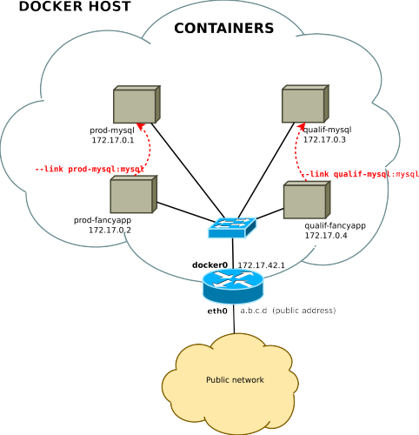
Intro
Containers
I/O
Images
Builder
Security
Ecosystem Future
Legacy links

Slide 38
Intro
Containers
I/O
Images
Builder
Security Ecosystem Future
User-defined networks (since v1.9.0)
by default new containers are connected to the main network (named “bridge”, 172.17.0.0/16)
the user can create additional networks:
docker network create NETWORK
newly created containers are connected to one network:
docker run --net=NETWORK
container may be dynamically attached/detached to any network:
docker network connect NETWORK CONTAINER
docker network disconnect NETWORK CONTAINER
networks are isolated from each other, communications is possible by attaching a container to multiple networks
Notes:
Bridge, host, overlay(between hosts), mcvlan

Slide 39
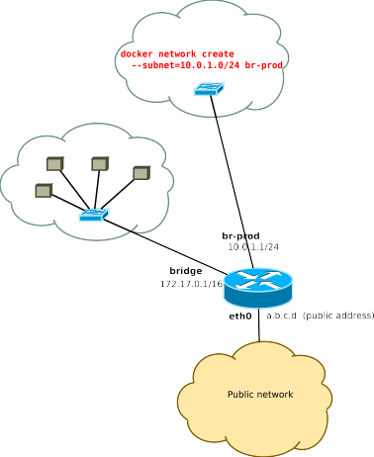
Intro
Containers
I/O
Images
Builder
Security
Ecosystem Future
User-defined networks example

Slide 40
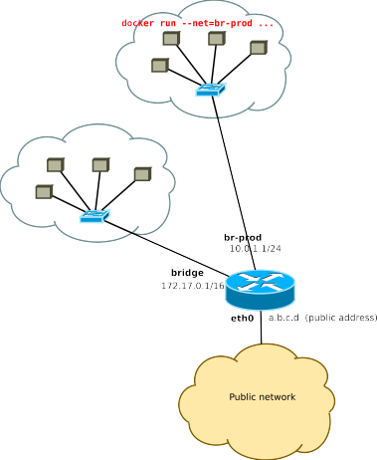
Intro
Containers
I/O
Images
Builder
Security
Ecosystem Future
User-defined networks example

Slide 41
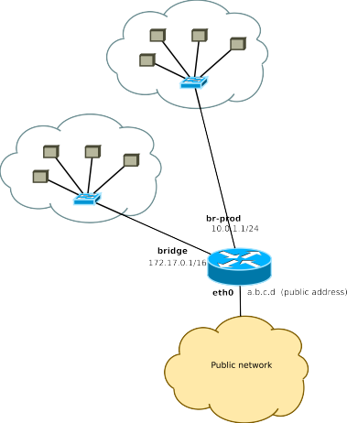
Intro
Containers
I/O
Images
Builder
Security
Ecosystem Future
User-defined networks example

Slide 42
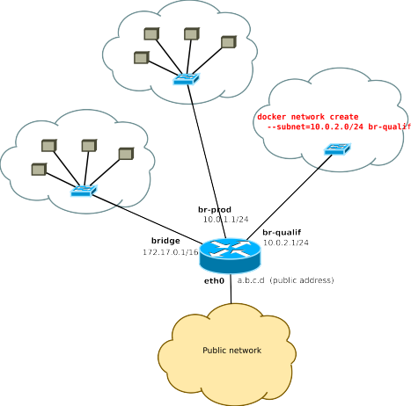
Intro
Containers
I/O
Images
Builder
Security
Ecosystem Future
User-defined networks example

Slide 43
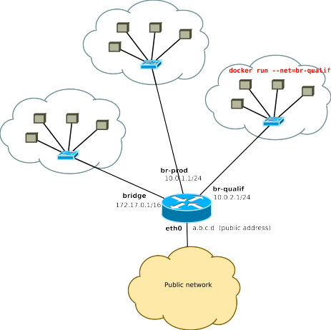
Intro
Containers
I/O
Images
Builder
Security
Ecosystem Future
User-defined networks example

Slide 44
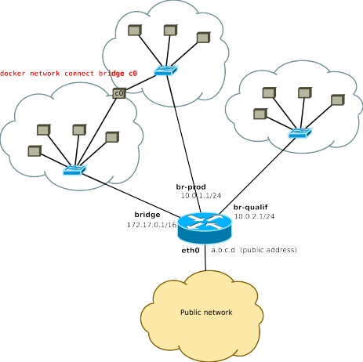
Intro
Containers
I/O
Images
Builder
Security
Ecosystem Future
User-defined networks example
Notes:
Maybe change graph slides to a single slide with one graph indicating different network drivers?

Slide 45
Intro
Containers
I/O
Images
Builder
Security
Ecosystem
Future
docker run — publish a TCP port
Containers are deployed in a private network, they are not reachable from the outside (unless a redirection is set up)
docker run -p [ipaddr:]hostport:containerport
→ redirect incoming connections to the TCP port hostport of the host to the TCP port containerport of the container
The listening socket binds to 0.0.0.0 (all interfaces) by default or to ipaddr if given

Slide 46
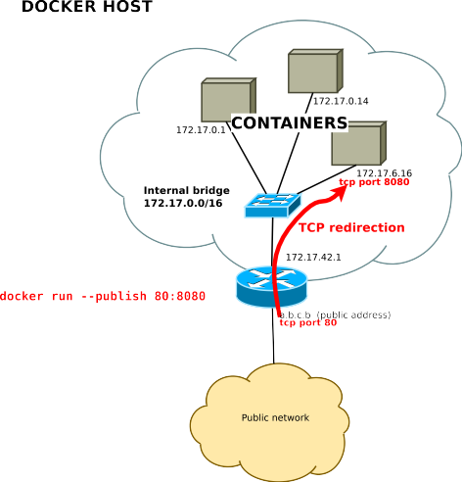
Intro
Containers
I/O
Images
Builder
Security
Ecosystem Future
publish example

Slide 47
Intro Containers
I/O
Images
Builder
Security
Ecosystem
Future
publish example
bind to all host addresses
$ docker run -d -p 80:80 nginx
52c9105e1520980d49ed00ecf5f0ca694d177d77ac9d003b9c0b840db9a70d62
$ wget -nv http://localhost/
2016-01-12 18:32:52 URL:http://localhost/ [612/612] -> "index.html" [1]
$ wget -nv http://172.17.42.1/
2016-01-12 18:33:14 URL:http://172.17.42.1/ [612/612] -> "index.html" [1]
bind to 127.0.0.1
$ docker run -d -p 127.0.0.1:80:80 nginx
4541b43313b51d50c4dc2722e741df6364c5ff50ab81b828456ca55c829e732c
$ wget -nv http://localhost/
2016-01-12 18:37:10 URL:http://localhost/ [612/612] -> "index.html.1" [1]
$ wget http://172.17.42.1/
--2016-01-12 18:38:32-- http://172.17.42.1/
Connecting to 172.17.42.1:80... failed: Connection refused.

Slide 48
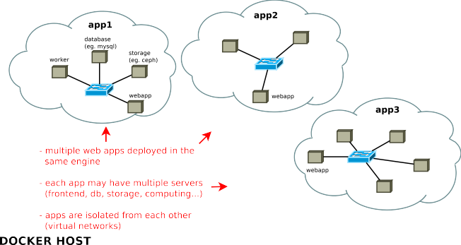
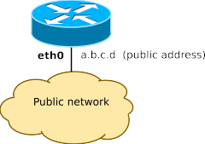
Intro
Containers
I/O
Images
Builder
Security
Ecosystem Future
The whole picture

Slide 49
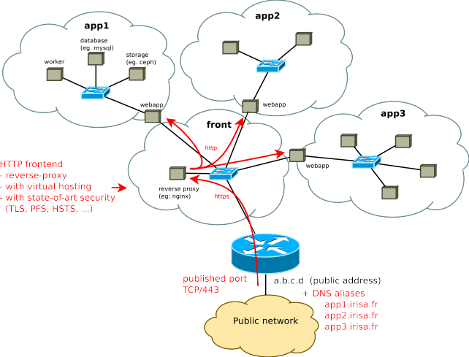
Intro
Containers
I/O
Images
Builder
Security
Ecosystem Future
The whole picture

Slide 50
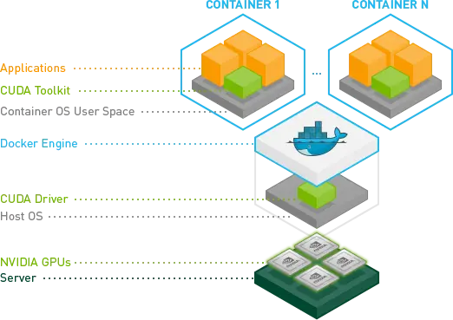
GPU Access
(Nvidia runtime)
Notes:
docker run --gpus all nvidia/cuda:11.0-base nvidia-smi https://saturncloud.io/blog/how-to-use-gpu-from-a-docker-container-a-guide-for-data-scientists-and-software-engineers/#:~:text=Resource%20Allocation%3A%20Docker's%20in%2Dbuilt,demands%20or%20large%20application%20sizes. To make your AMD GPU accessible within a Docker container, you’ll need to install the AMD ROCm (Radeon Open Compute) software stack on your host system. ROCm provides the necessary drivers and tools for GPU acceleration - /dev/dri/renderD128:/dev/dri/renderD128

Slide 51
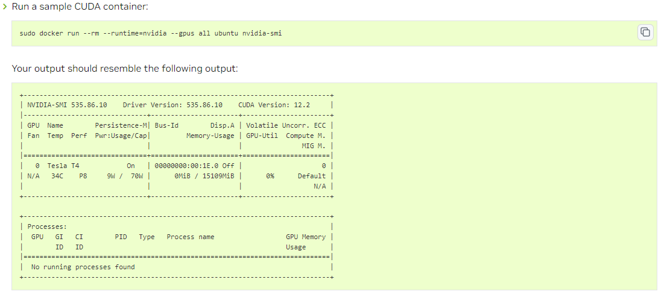
Nvidia SMI
Notes:
https://docs.nvidia.com/datacenter/cloud-native/container-toolkit/latest/sample-workload.html

Slide 52
Intro
Containers
I/O
Images
Builder
Security
Ecosystem
Future
Part 4.
Managing docker images

Slide 53
Intro
Containers
I/O
Images
Builder
Security
Ecosystem Future
Docker images
A docker image is a snapshot of the filesystem + some metadata
immutable
copy-on-write storage
for instantiating containers
for creating new versions of the image (multiple layers)
identified by unique hex IDs
Image ID: randomly genreated
Digest: hashed from the content
may be tagged¹ with a human-friendly name
eg: debian:wheezy debian:jessie debian:latest
¹possibly multiple times
Notes:
Dive – a tool for analyzing images unionFS – layered, only top layer is writable during container run
Id is based on content, layers, metadata and config
Digest is only a hash of contents, like a checksum to varifiy the image is really what it claims to be

Slide 54
Intro
Containers
I/O
Images
Builder
Security
Ecosystem Future
Image management commands
command |  | description
docker images docker history image docker inspect image. . . |  | list all local images show the image history (list of ancestors) show low-level infos (in json format)
docker | tag image tag | tag an image
docker commit container image |  | create an image
 |  | (from a container)
docker import url|- [tag] |  | create an image
 |  | (from a tarball)
docker | rmi image. . . | delete images
Notes:
When a locally built image is pushed to a registry, it is only the leaf image that is uploaded along with its constituent layers, and a subsequent pull by another Docker host will not yield any intermediate parent images.
This is because once the image is made available to other potential users on different Docker hosts via a registry, it effectively becomes read-only, and the components that support the build cache are no longer required. Instead of the image ID, <missing> is inserted into the history output in its place.
Load brings an image from save tar, retaining original repo:tagging, import creates a new image from a tar

Slide 55
Intro
Containers
I/O
Images
Builder
Security
Ecosystem Future
Example: images & containers

Slide 56
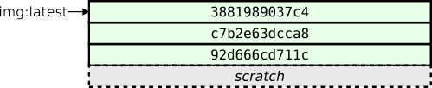
Intro
Containers
I/O
Images
Builder
Security
Ecosystem Future
Example: images & containers

Slide 57
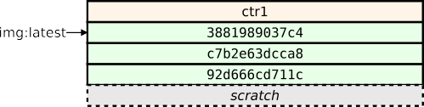
Intro
Containers
I/O
Images
Builder
Security
Ecosystem Future
Example: images & containers

Slide 58
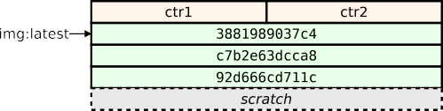
Intro
Containers
I/O
Images
Builder
Security
Ecosystem Future
Example: images & containers

Slide 59
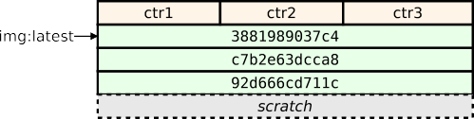
Intro
Containers
I/O
Images
Builder
Security
Ecosystem Future
Example: images & containers

Slide 60
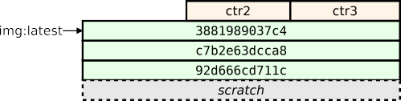
Intro
Containers
I/O
Images
Builder
Security
Ecosystem Future
Example: images & containers

Slide 61
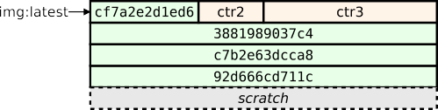
Intro
Containers
I/O
Images
Builder
Security
Ecosystem Future
Example: images & containers

Slide 62
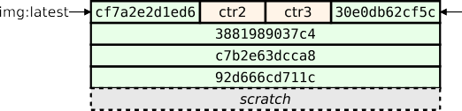
Intro
Containers
I/O
Images
Builder
Security
Ecosystem Future
Example: images & containers

Slide 63
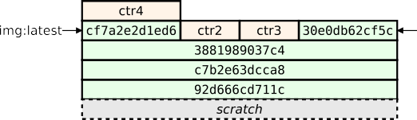
Intro
Containers
I/O
Images
Builder
Security
Ecosystem Future
Example: images & containers

Slide 64
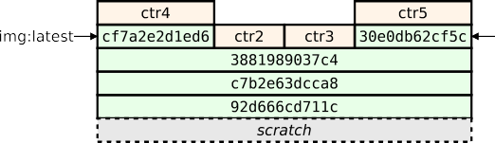
Intro
Containers
I/O
Images
Builder
Security
Ecosystem Future
Example: images & containers

Slide 65
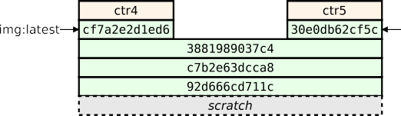
Intro
Containers
I/O
Images
Builder
Security
Ecosystem Future
Example: images & containers

Slide 66
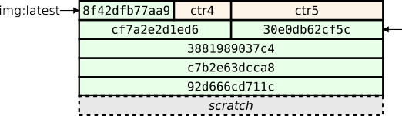
Intro
Containers
I/O
Images
Builder
Security
Ecosystem Future
Example: images & containers

Slide 67
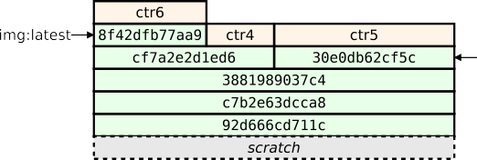
Intro
Containers
I/O
Images
Builder
Security
Ecosystem Future
Example: images & containers

Slide 68
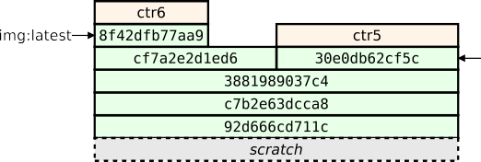
Intro
Containers
I/O
Images
Builder
Security
Ecosystem Future
Example: images & containers

Slide 69
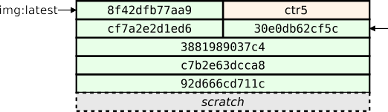
Intro
Containers
I/O
Images
Builder
Security
Ecosystem Future
Example: images & containers

Slide 70
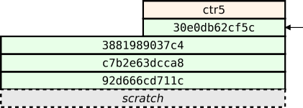
Intro
Containers
I/O
Images
Builder
Security
Ecosystem Future
Example: images & containers

Slide 71
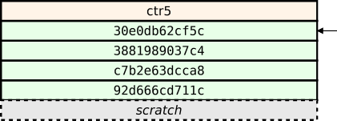
Intro
Containers
I/O
Images
Builder
Security
Ecosystem Future
Example: images & containers

Slide 72
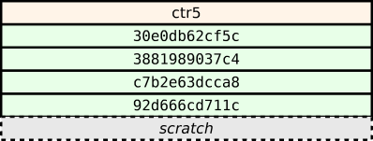
Intro
Containers
I/O
Images
Builder
Security
Ecosystem Future
Example: images & containers

Slide 73
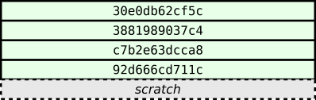
Intro
Containers
I/O
Images
Builder
Security
Ecosystem Future
Example: images & containers

Slide 74
Intro
Containers
I/O
Images
Builder
Security
Ecosystem Future
Example: images & containers

Slide 75

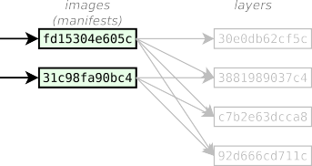
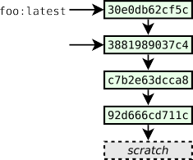
Intro
Containers
I/O
Images
Builder
Security
Ecosystem Future
Images vs. Layers
Notes:
Shorten last ten slides to a single one with a flowchart?

Slide 76
Intro Containers
I/O
Images
Builder
Security
Ecosystem Future
Image tags
A docker tag is made of two parts: “REPOSITORY:TAG”
The TAG part identifies the version of the image. If not provided, the default is “:latest”
$ docker images
REPOSITORY TAG IMAGE ID CREATED
VIRTUAL SIZE
122.6 MB
122.6 MB
122.6 MB
159.9 MB
159.9 MB
112.4 MB
112.4 MB
115 MB
115 MB
115 MB
123.6 MB
121.8 MB
115 MB
123.6 MB
115 MB
debian debian debian debian debian debian debian debian debian debian debian debian debian debian debian
8
8.0
jessie rc-buggy
835c4d274060 2 weeks ago 835c4d274060 2 weeks ago 835c4d274060 2 weeks ago 350a74df81b1 7 months ago
experimental 36d6c9c7df4c 7 months ago
6.0.9
squeeze wheezy latest 7.5
unstable testing stable sid
7.4
7.3
3b36e4176538 7 months ago 3b36e4176538 7 months ago 667250f9a437 7 months ago 667250f9a437 7 months ago 667250f9a437 7 months ago 24a4621560e4 7 months ago 7f5d8ca9fdcf 7 months ago caa04aa09d69 7 months ago f3d4759f77a7 7 months ago e565fbbc6033 9 months ago
debian
b5fe16f2ccba 11 months ago 117.8 MB

Slide 77
Intro
Containers
I/O
Images
Builder
Security
Ecosystem
Future
Tagging conventions (1/2)
Local tags may have arbitrary names, however the docker push
and docker pull commands expect some conventions
The REPOSITORY identifies the origin of the image, it may be:
a name (eg: debian)
→ refers to a repository on the official registry
→ https://store.docker.com/
a hostname+name (eg: some.server.com/repo)
→ refers to an arbitrary server supporting the registry API
→ https://docs.docker.com/reference/api/registry_api/

Slide 78
Intro
Containers
I/O
Images
Builder
Security
Ecosystem
Future
Tagging conventions (2/2)
Use slashes to delimit namespaces (for subprojects):
image name | description
debian | (semi-)official debian images
fedora | official fedora images
fedora/apache | apache images provided by the fedora project
fedora/couchdb | couchdb images provided by the fedora project

Slide 79
Intro
Containers
I/O
Images
Builder
Security
Ecosystem
Future
Image transfer commands
Using the registry API
docker pull repo[:tag]. . . docker push repo[:tag]. . . docker search text | pull an image/repo from a registry push an image/repo from a registry search an image on the official registry
docker login . . . docker logout . . . | login to a registry logout from a registry
Manual transfer
docker save repo[:tag]. . . docker load | export an image/repo as a tarball load images from a tarball
docker-ssh . . . | script to transfer images between two daemons over ssh
Notes:
/etc/docker/daemon.json
https://docs.docker.com/config/daemon/
(for daemon default override)
Home/.docker/config.json (for registry login details)

Slide 80


Intro
Containers
I/O
Images
Builder
Security
Ecosystem Future
Transferring images

Slide 81
Intro
Containers
I/O
Images
Builder
Security
Ecosystem
Future
Part 5.
Docker builder

Slide 82
Intro
Containers
I/O
Images
Builder
Security
Ecosystem
Future
What is the Docker builder ?
Docker’s builder relies on
a DSL describing how to build an image
a cache for storing previous builds and have quick iterations
The builder input is a context, i.e. a directory containing:
a file named Dockerfile which describes how to build the image
possibly other files to be used during the build

Slide 83
Intro
Containers
I/O
Images
Builder
Security
Ecosystem Future
Build an image
docker build [ -t tag ] path
→ build an image from the context located at path and optionally tag it as tag
The command:
makes a tarball from the content¹² of path
uploads the tarball to the docker daemon which will:
execute the content of Dockerfile, committing an intermediate image after each command
(if requested) tag the final image as tag
¹²unwanted files may be excluded if they match patterns listed in
.dockerignore

Slide 84
Intro
Containers
I/O
Images
Builder
Security
Ecosystem
Future
Dockerfile example
# base image: last debian release
FROM debian:wheezy
# install the latest upgrades
RUN apt-get update && apt-get -y dist-upgrade
# install nginx
RUN apt-get -y install nginx
# set the default container command # −> run nginx in the foreground
CMD ["nginx", "-g", "daemon off;"]
# Tell the docker engine that there will be somenthing listening on the tcp port 80
EXPOSE 80

Slide 85
Intro
Containers
I/O
Images
Builder
Security
Ecosystem
Future
Dockerfile format
https://docs.docker.com/reference/builder/
comments start with “#”
commands fit on a single line
(possibly continued with \)
first command must be a FROM
(indicates the parent image or scratch to start from scratch)

Slide 86
Intro
Containers
I/O
Images
Builder
Security
Ecosystem
Future
Builder instructions (1/3)
Instructions affecting the image filesystem
instruction | description
FROM image|scratch | base image for the build
COPY path dst | copy path from the context into the container at location dst
ADD src dst | same as COPY but untar archives and accepts http urls
RUN command | run an arbitrary command inside the container
Note: commands may be expressed as a list (exec) or a string (shell)
# exec form
RUN ["apt-get", "update"]
# shell form
RUN apt-get update # equivalent to: RUN [”/bin/sh”, ”−c”, ”apt−get update”]
Notes:
docker builder prune (-f) to clear build cache
docker build --no-cache -t your_image_name . To build without the cache

Slide 87
Intro
Containers
I/O
Images
Builder
Security
Ecosystem
Future
Builder instructions (2/3)
Instructions setting the default container config¹³
instruction | description
CMD command ENTRYPOINT command | command run inside the container entrypoint¹⁴
USER name[:group] WORKDIR path ENV name="value". . . | user running the command working directory environment variables
STOPSIGNAL signal | signal to be sent to terminate the container(instead of SIGTERM)
HEALTHCHECK CMD command | test command to check whether the container works well
EXPOSE port. . . VOLUME path. . . | listened TCP/UDP ports mount-point for external volumes
LABEL name="value". . . | arbitrary metadata
¹³i.e. the default configuration of containers running this image
¹⁴the ENTRYPOINT is a commmand that wraps the CMD command

Slide 88
Intro
Containers
I/O
Images
Builder
Security
Ecosystem
Future
Builder instructions (3/3)
Extra instructions
instruction | description
ARG name[=value] | build-time variables
ON BUILD instruction | instruction run when building a derived image
build-time variables are usable anywhere in the Dockerfile (by variable expansion: $VARNAME) and are tunable at build time: “docker build --build-arg name=value . . . ”
instructions prefixed with ONBUILD are not run in this build, their execution is triggered when building a derived image

Slide 89
Intro
Containers
I/O
Images
Builder
Security
Ecosystem
Future
Builder cache
Each layer created by the builder is fingerprinted according to:
the ID of the previous image
the command and its arguments
the content of the imported files (for ADD and COPY)
RUN’s side-effects are not fingerprinted
When rebuilding an image docker will reuse a previous image if its fingerprint is the same

Slide 90
Intro
Containers
I/O
Images
Builder
Security
Ecosystem
Future
Good practices¹⁵ for docker files
use stable base images (eg. debian:jessie)
run the app as PID 1 inside the container (to be killable)
→ write CMD ["app", "arg"] instead of CMD app arg
standardise the config, but allow the admin to override it with env variables or additional config files
(eg. ENV MYSQL HOST="mysql")
¹⁵see also https://docs.docker.com/engine/userguide/eng-image/dockerfile_best-practices/

Slide 91
Intro
Containers
I/O
Images
Builder
Security
Ecosystem
Future
Multi-stage build (since v17.05)
#======= Stage 1: build the app from sources =======#
FROM debian:stretch AS builder
# update the package lists an install the build dependencies
RUN apt-get -qqy update
RUN apt-get -qqy install gcc make libacme-dev
# install the sources in /opt/src and build them
COPY . /opt/src
RUN cd /opt/src && ./configure && make
# install the files in a tmp dir and make an archive that we can deploy elsewhere
RUN cd /opt/src && make install DESTDIR=/tmp/dst \ && cd /tmp/dst && tar czvf /tmp/myapp.tgz .
#======= Stage 2: final image ================#
FROM debian:stretch
# update the package lists and install the runtime dependencies
RUN apt-get -qqy update
RUN apt-get -qqy install libacme1.0
# install the app built in stage 1
COPY --from=builder /tmp/myapp.tgz /tmp/ RUN cd / && tar zxf /tmp/myapp.tgz
CMD ["myapp"]

Slide 92
Intro
Containers
I/O
Images
Builder
Security
Ecosystem
Future
Part 6. Security
host/container isolation
container/container isolation
other security considerations

Slide 93
Intro
Containers
I/O
Images
Builder
Security
Ecosystem Future
Security strategies
Docker containers are not really sandboxed from the host machine. They talk with the same kernel. You may want to consider strategies to reduce the risks of privilege escalation.
Container/Host isolation
run the container with an ordinary user (docker run -u)
reduce root privileges (capabilities, seccomp, apparmor)
configure a user namespace
run the docker engine inside a VM
Container/Container isolation
disable intercontainer communications (--icc=false)
isolate containers in different networks

Slide 94
Intro
Containers
I/O
Images
Builder
Security
Ecosystem
Future
Running containers as normal user
docker run -u USER ...
should be safe, but...
setuid executables in the docker image
→ should mount /var/lib/docker with ‘-o nosuid’
setuid executables in external volumes
→ should mount all data volumes with ‘-o nosuid’
/etc/passwd in the docker image
→ should use numeric ids: (docker run -u UID:GID)
→ not easily enforceable if the image provider is malicious

Slide 95
Intro
Containers
I/O
Images
Builder
Security
Ecosystem
Future
Reduced root capabilities
kernel capabilities supported since docker v1.2
containers use a default set limited to 14 capabilities¹⁶:
AUDIT WRITE DAC OVERRIDE
NET BIND SERVICE
SYS CHROOT
CHOWN FSETID FOWNER MKNOD
NET RAW SETPCAP SETGID KILL SETUID
SETFCAP
add additional capabilities: docker run --cap-add=XXXXX ...
drop unnecessary capabilities: docker run --cap-drop=XXXXX ...
→ should use --cap-drop=all for most containers
$ docker run --rm -t -i debian
root@04223cbb1334:/# ip addr replace 172.17.0.42/16 dev eth0 RTNETLINK answers: Operation not permitted root@04223cbb1334:/# exit
$ docker run --rm -t -i --cap-add NET_ADMIN debian root@9bf2a570a6a6:/# ip addr replace 172.17.0.42/16 dev eth0 root@9bf2a570a6a6:/#
¹⁶over the 38 capabilities defined in the kernel (man 7 capabilities)

Slide 96
Intro
Containers
I/O
Images
Builder
Security
Ecosystem
Future
Reduced syscall whitelist
seccomp-bpf == fine-grained acces control to kernel syscalls
enabled by default since docker v1.10
default built-in profile¹⁷ whitelists only harmless syscalls¹⁸
alternative configs:
disable seccomp (--security-opt=seccomp:unconfined)
provide a customised profile (derived from the default¹⁹)
$ docker run --rm debian date -s 2016-01-01
date: cannot set date: Operation not permitted
$ docker run --rm --cap-add sys_time debian date -s 2016-01-01
date: cannot set date: Operation not permitted
$ docker run --rm --security-opt seccomp:unconfined debian date -s 2016-01-01
date: cannot set date: Operation not permitted
$ docker run --rm --cap-add sys_time --security-opt seccomp:unconfined debian date -s 2016-01-01
Fri Jan 1 00:00:00 UTC 2016
¹⁷https://docs.docker.com/engine/security/seccomp/
¹⁸harmful means everything that deals with administration (eg: set time) or debugging (eg: ptrace) ¹⁹https://github.com/moby/moby/blob/master/profiles/seccomp/default.json

Slide 97
Intro
Containers
I/O
Images
Builder
Security
Ecosystem
Future
User namespaces
since docker v1.10 but not enabled by default
UIDs/GIDs inside the containers mapped to another range outside the container
useful for:
preventing fs-based attacks (eg: root user inside the container creates a setuid executable in an external volume)
isolating docker users from each other (one docker daemon for each user, with uids remapped to different ranges)
limits (as of v1.10)
global config only (daemon scope)
coarse mapping only (hardcoded range: 0..65535)

Slide 98
Intro
Containers
I/O
Images
Builder
Security
Ecosystem Future
Docker is not a sandbox !
Even with capabilities+seccomp+user namespaces enabled, you may still be vulnerable, because the kernel’s attack surface is big
CVE-2019-5736
runc through 1.0-rc6, as used in Docker before 18.09.2 and other products, allows attackers to overwrite the host runc binary (and consequently obtain host root access)
CVE-2018-15664
In Docker through 18.06.1-ce-rc2, the API endpoints behind the ’docker cp’ command are vulnerable to a symlink-exchange attack with Directory Traversal, giving attackers arbitrary read-write access to the host filesystem with root privileges

Slide 99
Intro
Containers
I/O
Images
Builder
Security Ecosystem Future
Run the docker engine inside a VM
Hypervisors have a smaller attack surface and are much more mature that containers. Use a VM if you need good isolation!
either manually-administrated VMs
or transparently-launched VMs
on a per-engine basis (docker daemon inside a VM)
docker machine: https://docs.docker.com/machine/overview/
on a per-container basis (each container in a separate VM)
kata containers: https://katacontainers.io/
runv: https://github.com/hyperhq/runv
gvisor: https://github.com/google/gvisor

Slide 100
Intro
Containers
I/O
Images
Builder
Security
Ecosystem
Future
Container/Container isolation
by default all containers can connect to any other container (located in the same bridge)
run the daemon with --icc=false
all communications filtered by default
whitelist-based access with --link
(only EXPOSEd ports will be whitelisted)
attach containers to different networks
by default RAW sockets are enabled (allows ARP spoofing)²⁰
→ use docker run --cap-drop=NET RAW
²⁰http://lwn.net/Articles/689453

Slide 101
Intro
Containers
I/O
Images
Builder
Security
Ecosystem Future
Other security considerations
images are immutable
→ need a process to apply automatic security upgrades, e.g:
apply upgrades & commit a new image
regenerate the image from the Dockerfile
docker engine control == root on the host machine
give access to the docker socket only to trusted users
avoid docker run --privileged (gives full root access)
beware of symlinks in external volumes
eg. ctr1 binds /data, ctr2 binds /data/subdir, if both are malicious and cooperate, ctr1 replaces
/data/subdirwith a symlink to /, then on restart ctr2 has access to the whole host filesystem
→ avoid binding subdirectories, prefer using named volumes

Slide 102
Intro
Containers
I/O
Images
Builder
Security
Ecosystem Future
Install Docker As A Non-Root User (Rootless Mode)
Mitigate potential vulnerabilities in the deamon and container runtime
Execute the daemon in a user namespace
Has limitations as the daemon itself lacks privileges
https://docs.docker.com/engine/security/rootless
Notes:
Default user is root inside the container but is mapped to a non privileged user in the host

Slide 103
Intro
Containers
I/O
Images
Builder
Security
Ecosystem
Future
Part 7.
Docker Ecosystem
infrastructure
docker machine (provisioning)
docker swarm (clustering)
swarm mode (clustering)
underlying projects (moby, containerd, infrakit, ...)
container deployment & configuration
docker compose
image distribution
docker distribution (registry)
docker notary (content trust, image signing)

Slide 104
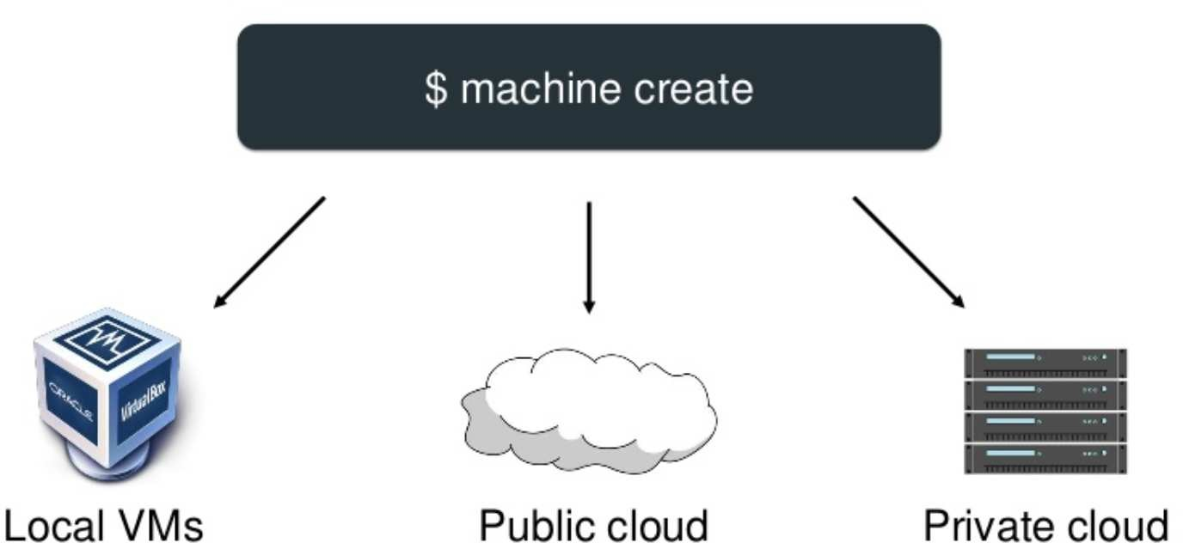
Intro
Containers
I/O
Images
Builder
Security
Ecosystem Future
Docker Machine
abstraction for provisionning and using docker hosts

Slide 105
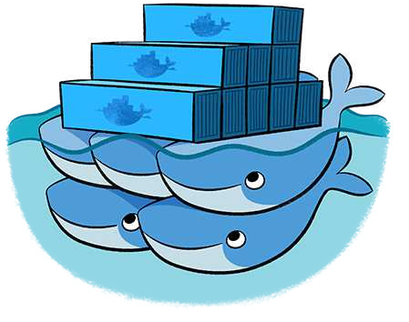
Intro
Containers
I/O
Images
Builder
Security
Ecosystem
Future
Docker Swarm
manage a cluster of hosts running docker
Docker Inc. folks are misleading: the name
swarm is actually used for two different products:
docker swarm (or legacy swarm or just swarm)
early solution (first released in dec 2014)
standalone server
superset of the docker engine API
requires an external discovery service (eg. etcd, consul)
network-agnostic (overlay networks to be configured separately)
the swarm mode
embedded within the docker engine (since v1.12 in july 2016)
turnkey cluster (integrated discovery service, distributed, network aware, encryption by default)
API break: introduces the service abstration

Slide 106
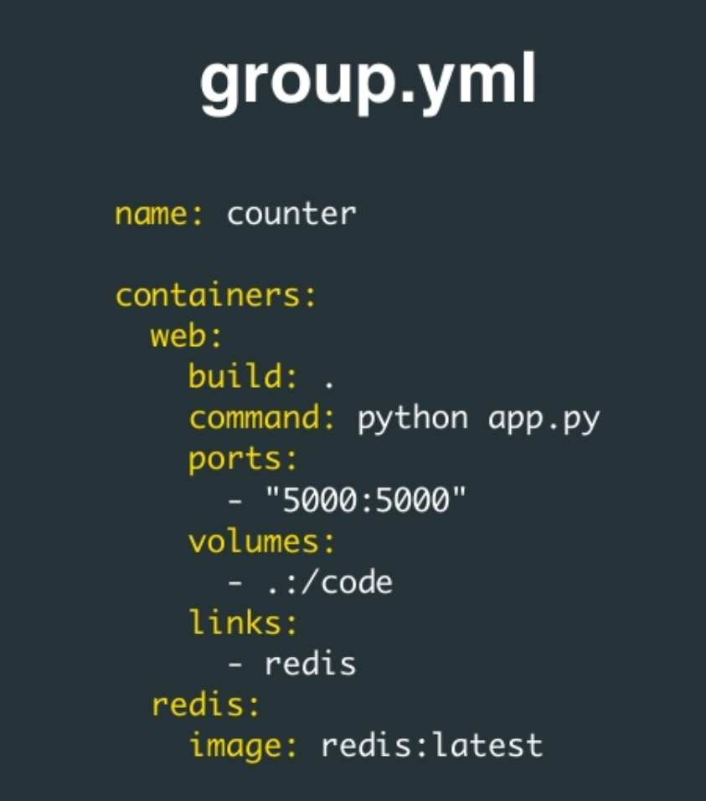
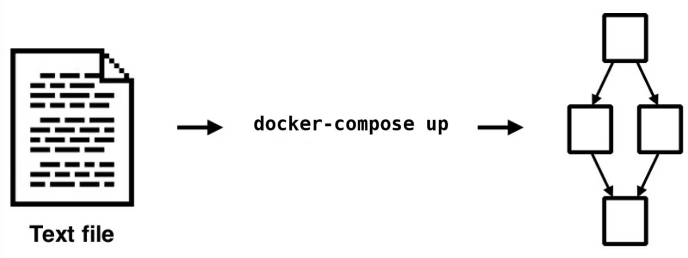
Intro
Containers
I/O
Images
Builder
Security
Ecosystem Future
Docker Compose
configure and deploy a collection of containers

Slide 107
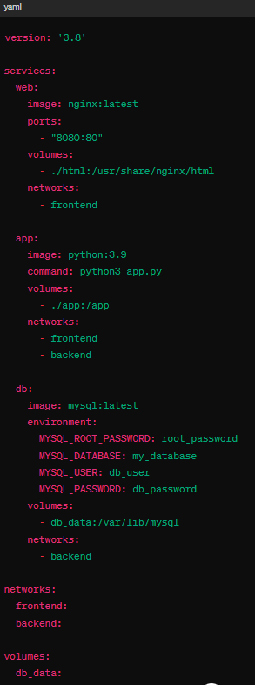
Intro
Containers
I/O
Images
Builder
Security
Ecosystem Future
Docker Compose
configure and deploy a collection of containers
Notes:
Docker-compose up –d
Deploy:
replicas: 3

Slide 108
Intro
Containers
I/O
Images
Builder
Security
Ecosystem
Future
Part 8.
The Future is Now
swarm mode (since v1.12)
plugins (since v1.13)
experimental features
Docker EE & time-based releases
The Orchestration Wars
Notes:
Change the entire chapter to orchestration and advanced?

Slide 109
Intro
Containers
I/O
Images
Builder
Security
Ecosystem
Future
The Future is Now
Swarm mode (since v1.12)
service abstraction
scaling
service discovery & load balancing
rolling updates
stack deployment (docker-compose) (since v1.13)
secrets management (since v1.13) + config objects (since v17.06)
plugins API for datacenter integration (since v1.13)
volume plugins (eg: flocker)
network plugins (eg: contiv)
authorization plugins
swarm secrets (since v17.07)

Slide 110
Intro
Containers
I/O
Images
Builder
Security
Ecosystem
Future
Docker CE & Docker EE
since march 2017
Docker inc’s business strategy:
be flexible and interoperable with everybody (especially cloud providers) so that no competing tool emerges
→ open source engine, plugin API for network, storage, authorization integrations
sell Docker EE
docker EE = docker CE + support + off-the-shelves datacenter management (ldap integration, role-based access-control, security scanning, vulnerability monitoring)

Slide 111
Intro
Containers
I/O
Images
Builder
Security
Ecosystem
Future
Time-based release
since march 2017 (docker v17.03.0-ce)
Docker CE
open source
edge version released every month
stable version released every 3 months
security upgrades during 4 months
Docker EE
proprietary
stable version released every 3 months
security upgrades during 1 year

Slide 112
Intro
Containers
I/O
Images
Builder
Security
Ecosystem Future
The Orchestration Wars
The Container Wars will actually be the Orchestration Wars
under the hood the base building blocs (runc, containerd) are open and the competitors cooperate to keep them standard.
docker itself is still free software, although the company culture is shifting towards something more “corporate”
the real fight is on orchestration solutions
managing clouds, service hosting
swarm has opponents (Mesos, Kubernetes, Openshift, ...) and is lagging.

Slide 113
Intro
Containers
I/O
Images
Builder
Security
Ecosystem
Future
Apache Mesos
predates Docker
designed for very large clusters
agnostic to the virtualisation technology
multiple virtualisation tools may coexist in the same cluster
two-level management
hard to configure

Slide 114
Intro
Containers
I/O
Images
Builder
Security
Ecosystem
Future
Kubernetes (k8s)
project started in 2014 by a group of google developers
inspired from Google’s internal orchestration framework
large scale, very sophisticated, not easy to learn
now hosted by a fundation and adopted by others that use it as their orchestration backend
Openshift
Docker EE

Slide 115
Intro
Containers
I/O
Images
Builder
Security
Ecosystem
Future
Container Runtime
Is in charge of interaction and managing containers (start/stop/pause)
Docker runs with containerd
Kubernetes uses docker engine, runc or other CRI (container runtime interface) implementation (CRI-O)

Slide 116
Intro
Containers
I/O
Images
Builder
Security
Ecosystem
Future
Simple ex.
Build simple Python app (hello browser page)
Create a Dockerfile for it
Run a container, verify the app
Use docker compose to control deployment

Slide 117

Intro
Containers
I/O
Images
Builder
Security
Ecosystem
Future
The Open Container Initiative (OCI)
https://github.com/opencontainers/
A Linux Foundation standard for linux containers:
v1.0.0 released in July 2017
runtime-spec (launching containers)
image-spec (image interoperability)

Slide 118
Intro
Containers
I/O
Images
Builder
Security
Ecosystem
Future
Install Minikube
https://minikube.sigs.k8s.io/docs/start/

